Slide 1

AY-2025-2026
ODD SEM
Department of ECE
Analog electronic Circuit Design
24ec2104
Topic:
BJT biasing circuits
Session - 04

Slide 2
Session content
General Biasing Circuits
Fixed Bias
Emitter Feedback Bias
Collector Feedback Bias

Slide 3



AIM OF THE SESSION
To demonstrate Biasing of BJT to desired Q-point
INSTRUCTIONAL OBJECTIVES
This Session is designed to:
  Demonstrate BJT biasing circuits
  Describe BJT desired operating point
LEARNING OUTCOMES
At the end of this session, you should be able to:
  Describe BJT biasing circuits
  Select biasing circuit for given application

Slide 4
Biasing in BJT Amplifier Circuits
Fixed Bias(Base Bias)
Self Bias/Voltage Divider Bias Circuits
Biasing Using a Collector-to-Base Feedback Resistor
Biasing using a Constant-Current Source

Slide 5
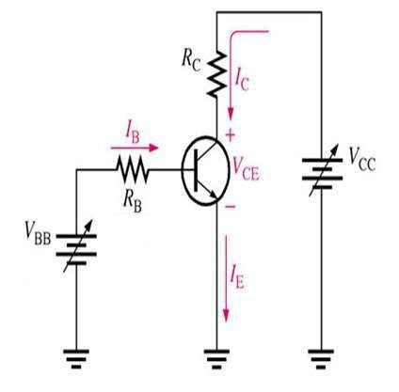
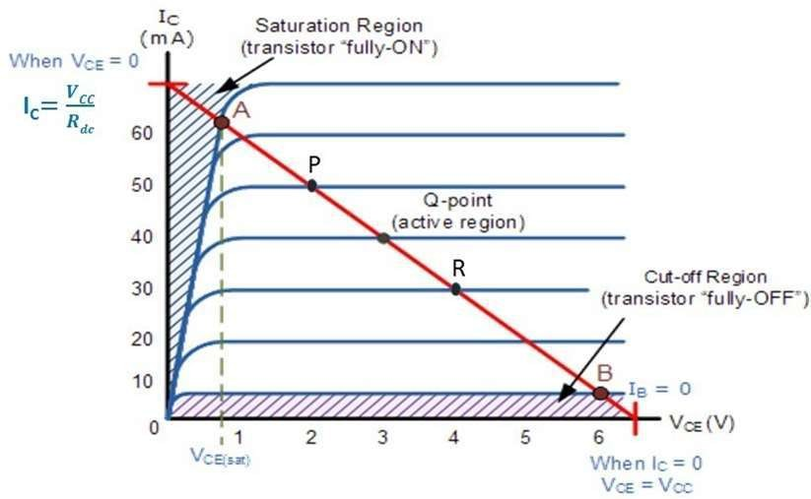
Biasing in BJT Amplifier Circuits
The biasing problem is that of establishing a constant dc current in the
collector of the BJT.

Slide 6
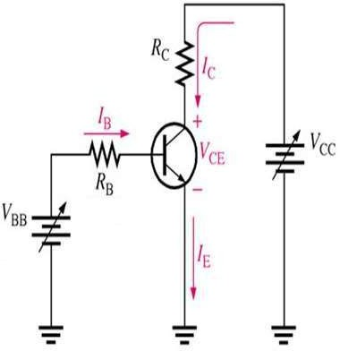
Biasing in BJT Amplifier Circuits
This current has to be calculable, predictable, and insensitive to variations in temperature and to the large variations in the value of β encountered among transistors of the same type.

Slide 7
Biasing in BJT Amplifier Circuits
Another important consideration in
bias design is locating the dc bias point in the iC–vCE plane to allow for maximum output signal swing.

Slide 8
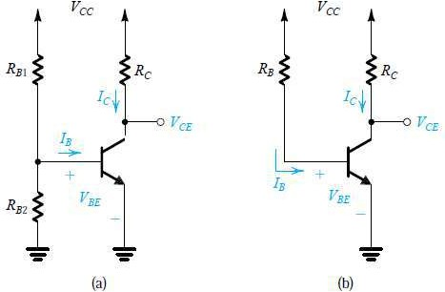
Fixed Bias/Base Bias
_{IC} = β _{I B}
₌ V CC ⁻V CE
R
I
C
C
^{V}CE
⁼VCC ⁻ IC RC
V_{E} = 0
₌ V CC ⁻V BE
=_{VC} −_{VE} =_{VC}
^{V}CE
^{V}CE
I
B
R
=_{VB} −_{VE} =_{VB}
B
^{V}BE ^{V}BE
Two obvious schemes for biasing the BJT: (a) by fixing VBE; (b) by fixing IB. Both result in wide variations in IC and hence in VCE and therefore are considered to be “bad.” Neither scheme is recommended.

Slide 9
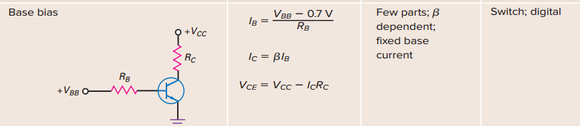
General biasing circuits
Fig. 4.1. Base bias for BJT

Slide 10
Fixed Bias/Base Bias
First, attempting to bias the BJT by fixing the voltage VBE by, for instance, using a voltage divider across the power supply VCC, is not a viable approach:
The very sharp exponential relationship iC–vBE means that any small and inevitable differences in VBE from the desired value will result in large differences in IC and in VCE.
Second, biasing the BJT by establishing a constant current in the base,where is also not a recommended approach.
Here the typically large variations in the value of β among units of the same device type will result in correspondingly large variations in IC and hence in VCE.

Slide 11
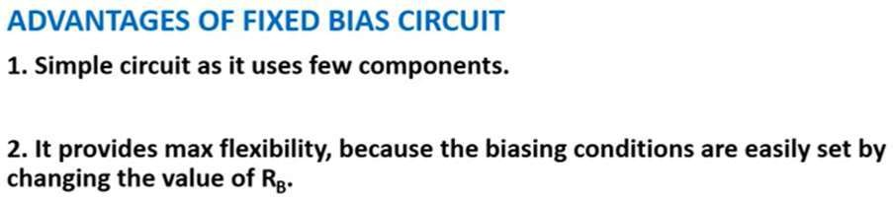
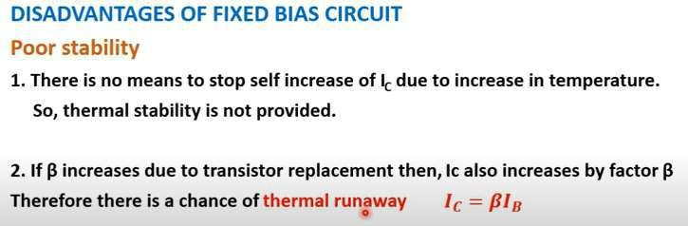
Fixed Bias/Base Bias

Slide 12
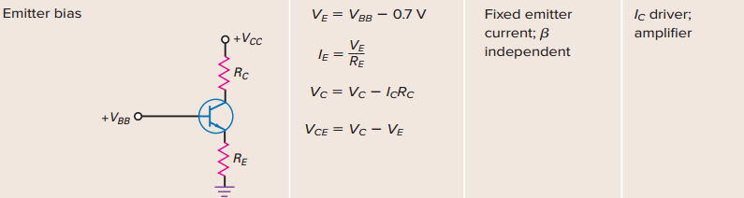
General biasing circuits
Fig. 4.2. Emitter bias for BJT

Slide 13
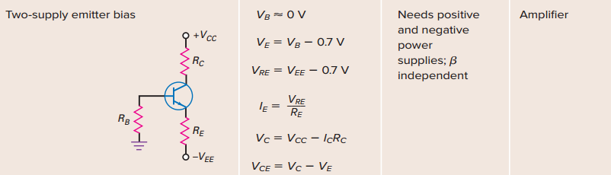
General biasing circuits
Fig. 4.3. Two supply emitter bias for BJT

Slide 14
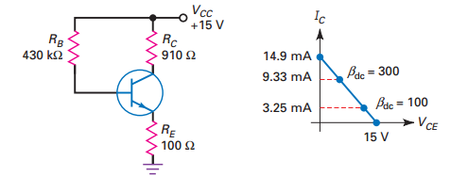
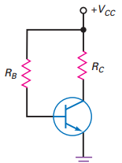
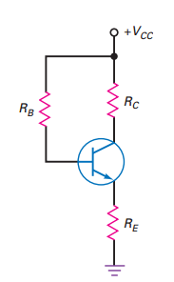
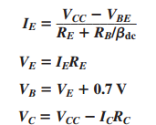
FIXED BIAS and EMITTER FEED BACK BIAS
Fixed Bias
Emitter Feedback Bias
Circuit Equations
Design
Large R_{E} value to swap out variations in β_{dc}
Fig. 4.6. Depicting Limitations of Emitter Feedback Bias – Variation in Q-point for change in β_{DC}
Fig. 4.4. Fixed Bias
Fig. 4.5. Emitter Feedback Bias
No Q-point Stabilization
First attempt for Q-Point stabilization using Emitter resistance
Large change in collector current for 3:1 change in current gain

Slide 15
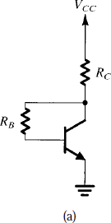
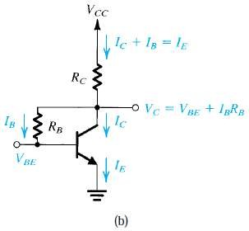
Biasing Using a Collector-to-Base Feedback
Resistor
The
resistor
circuit employs a
RB connected
between the collector and the base.
Resistor RB provides negative feedback, which helps to stabilize the bias point of the BJT.
= _{I E} R_{C} + _{I B} R_{B} +_{V BE}
I E
^{V}CC
V
=
I E
R + R +
CC
C
β +1
B
V BE
A CE transistor amplifier biased by a feedback resistor RB.
Analysis of the circuit in (a).

Slide 16
₌ V CC ⁻V BE
Biasing Using a Collector-to-Base Feedback Resistor
I
E
R
R_{CE} + _{β}
B
+1
RB
^{E} β +1
V CB ⁼ I B R
= _{I}
B
A CE transistor amplifier biased by a feedback resistor RB.
Analysis of the circuit in (a).

Slide 17
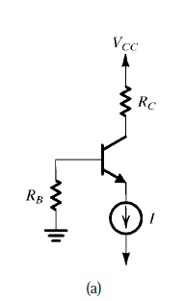

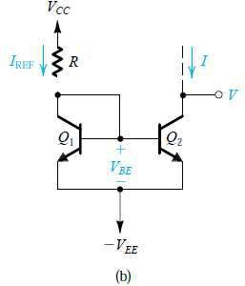

Biasing Using a Constant-Current Source
Current Mirror

Slide 18
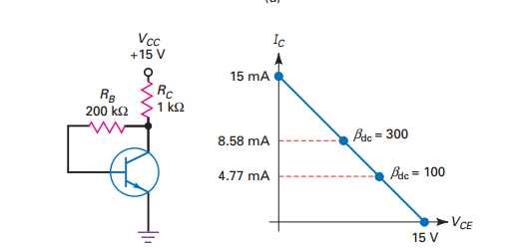
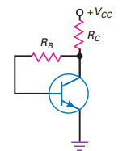
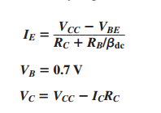

Collector FEED BACK BIAS
Collector Feedback Bias
Circuit Equations
Design
Fig. 4.8. Q-point for change in β_{DC}
Fig. 4.7. Collector Feedback Bias
Better Q-Point stabilization using Collector feedback resistance
Q point is less sensitive to changes in current gain

Slide 19
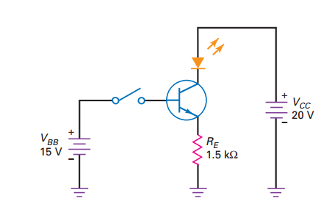
Example Problems
4.1 Calculate the Emitter resistance for Emitter bias as shown in Fig. 4.9 which could drive an LED of 21 mA Fig. 4.9.
Solution: Considering I_{E} ~ I_{C}
I_{E} = 21 mA
KVL in input loop gives
V_{BB} = V_{BE} + I_{E} R_{E}
Now, R_{E} = (15-0.7)/(21 mA) = 680 Ω
Fig. 4.9. Emitter bias for LED driving

Slide 20
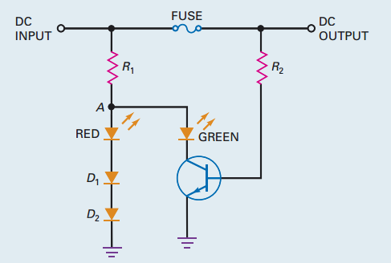

Example Problems
4.2. Identify the application of the Base Biased BJT circuit shown in Fig. 4.10.
Fig. 4.10. Base bias for BJT

Slide 21

SELF-ASSESSMENT QUESTIONS
Which Bias is suitable for Digital circuits?
Emitter Bias
Base Bias
Collector feedback Bias
Emitter feedback Bias
Which of the following bias is less effected by Beta variation?
Emitter feedback bias
Collector feedback bias

Slide 22
SELF-ASSESSMENT QUESTIONS
3. Which of the following biasing is suitable for IC driver application?
Emitter Bias
Base Bias
Collector feedback Bias
Emitter feedback Bias
4. Operating point of the BJT does not depend on temperature
False
True

Slide 23
ANSWERS
B
B
A
A

Slide 24
TERMINAL QUESTIONS
Describe the operation of Base bias. Sketch circuit obtain operating point.
Describe the operation of Emitter bias. Sketch circuit obtain operating point.
Describe the operation of two-supply bias. Sketch circuit obtain operating point.
Describe the operation of Fixed bias. Sketch circuit obtain operating point.
Describe the operation of Collector feedback bias. Sketch circuit obtain operating point.

Slide 25
REFERENCES FOR FURTHER LEARNING OF THE SESSION
Reference Books:
Albert Malvino, David Bate, “Electronic Principles”
Robert L. Boylestad and Louis Nashelsky - “Electronic Devices and Circuit Theory”

Slide 26
THANK YOU
Team – Analog electronic Circuit Design
Prepared by – Mr. S. Ravi Teja

